Slide 1


Time Consumption Analysis

Slide 2
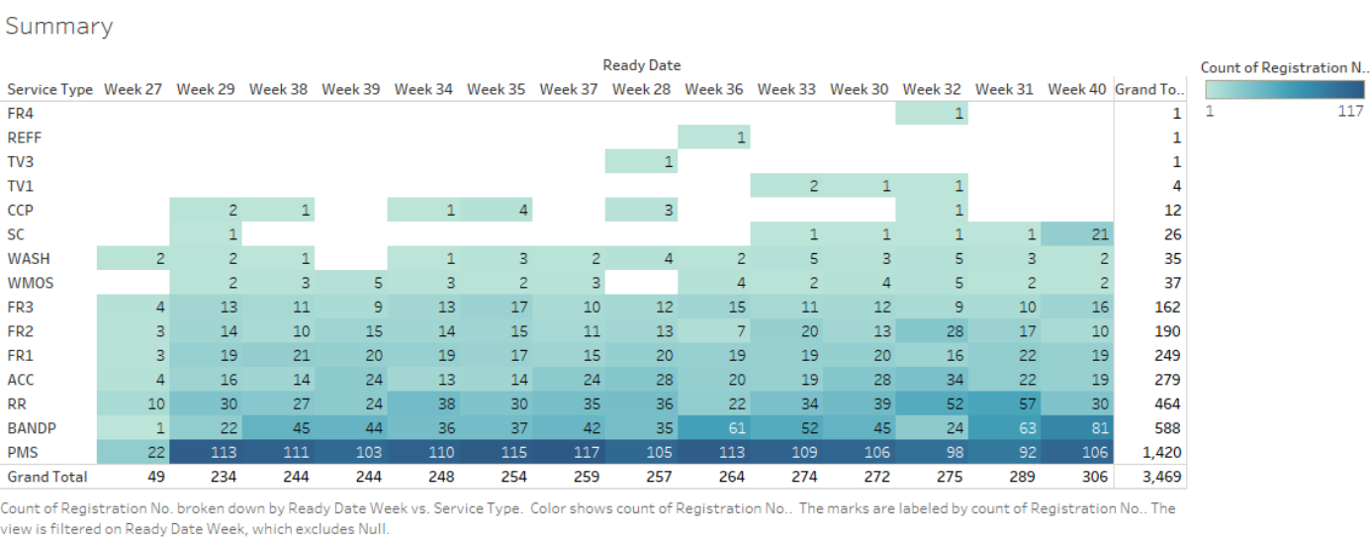
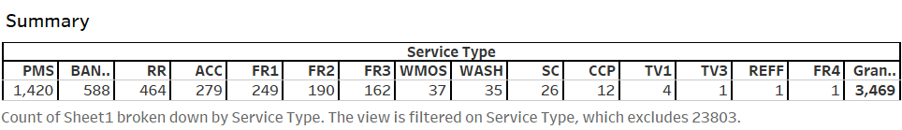

Slide 3
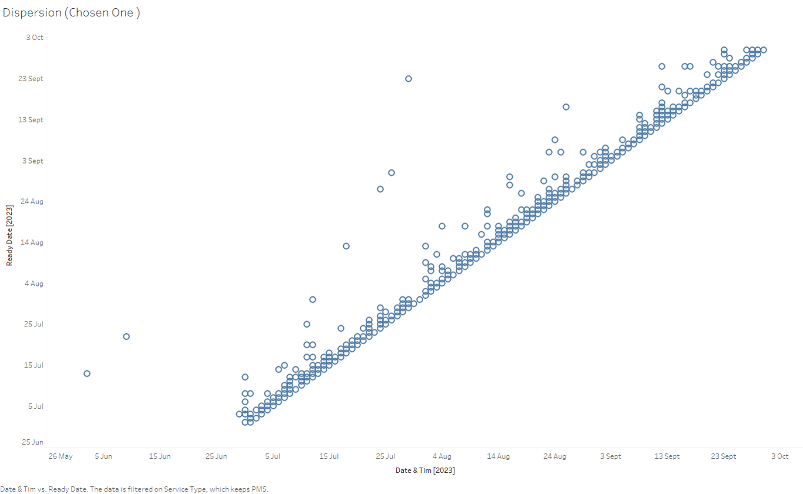
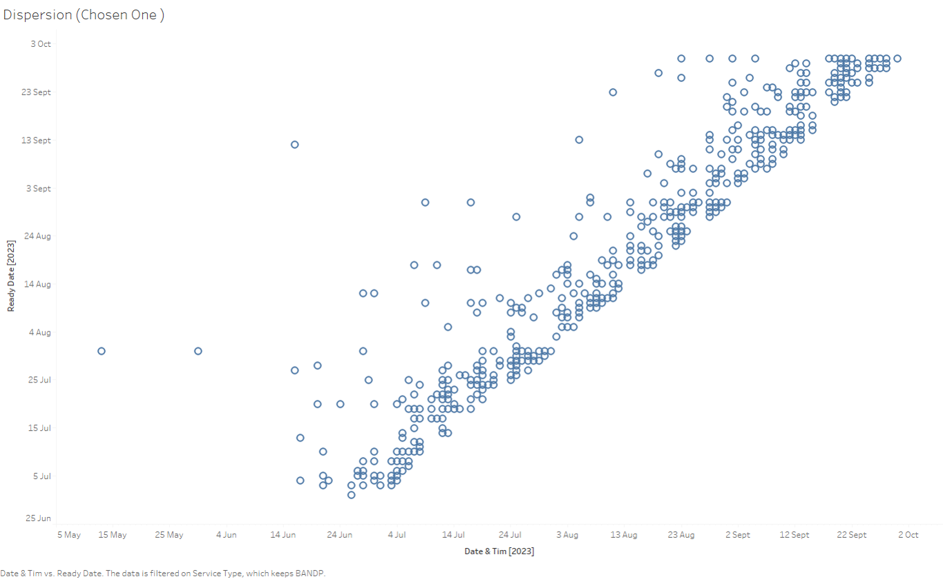
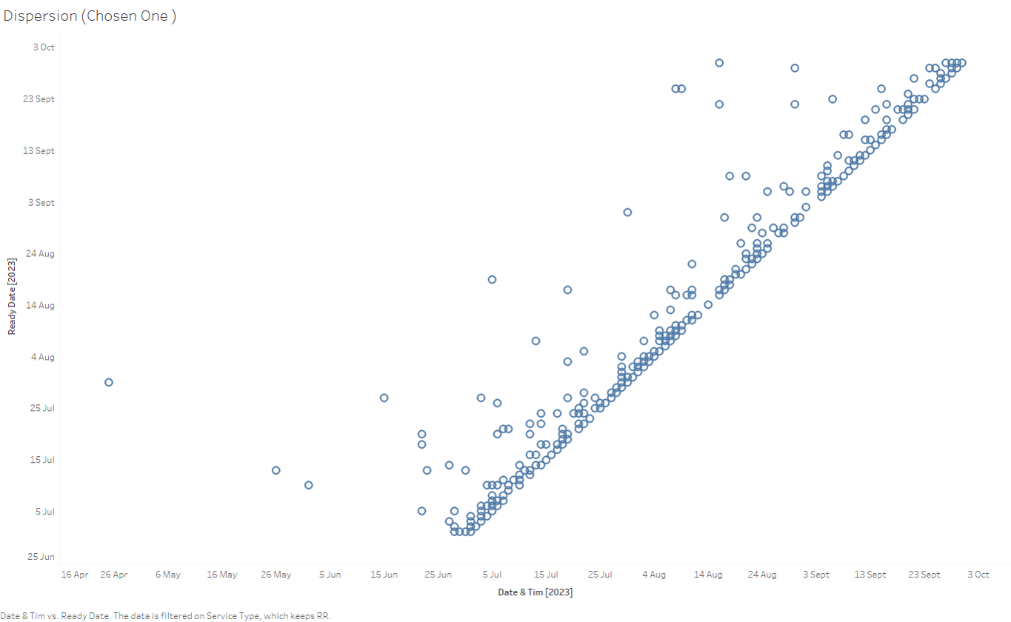
dispersion in completing BANDP service
PMS
RR
Dispersion of services based on their service time completion. The above three scatter plots show three services BANDP, PMS, RR

Slide 4

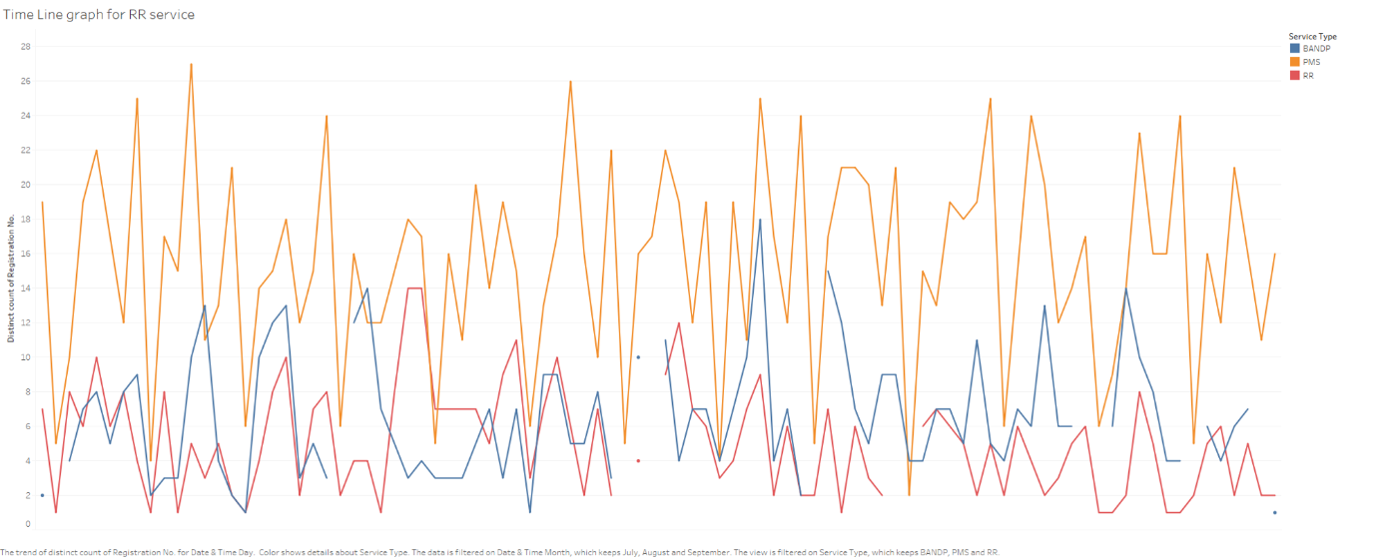
This graph represents the data wise analysis of car services requests based on their service type. Through the graph we can see that there is pattern when we consider the PMS services, which is Periodic maintenance service. It sipkes on Wednesdays and Saturdays, while have minimum requests on Sundays

Slide 5
